Slide 1


RevoGrocers Sales Performance Analysis
Lidia Puspa Ningtyas
March 14th, 2024
Linkedin - https://www.linkedin.com/in/lidia-p/

Slide 2

Business Overview & Disclaimer
Company Overview: RevoGrocers
RevoGrocers is a fictional grocery retail business that operates in multiple locations, offering a diverse range of grocery products to customers.
The company aims to optimize sales strategies, enhance customer experience, and increase revenue by leveraging data-driven decision-making.
Disclaimer
This analysis is based on a public dataset from Kaggle: Kaggle Grocery Sales Dataset﻿﻿
RevoGrocers is a fictional company created for analytical purposes.
﻿﻿Any insights or recommendations are based on this dataset and do not reflect real-world data.
Dataset Overview
Key Table Used
Sales (transaction data)
Products (product details)
Categories ( product category informations)
Relevan Field
Categoryid (product categories)
Categoryname (product categories by name)
Quantity (numbers of product sold)
Discount (discount detail)
Price (price detail)
CustomerID (unique user identifier)
Project Goal
Identify top-performing product categories.
﻿﻿Analyze factors driving revenue (units sold vs. customer count)
﻿﻿Evaluate pricing strategies and their impact on sales.

Slide 3
Methodology
Approach Taken
Data cleaning and transformation using SQL (BigQuery)
Using statistical hypothesis tests to determine relationships between key metrics; Revenue vs. Total Units Sold and Revenue vs. Unique Customers
Tools Used: Google BigQuery - for running SQL queries and analyzing structured datasets
Key SQL Queries
For each analysis, include:
﻿﻿Query Explanation
﻿﻿Formatted SQL Query
﻿﻿Screenshot of Query Output
Insight
Link query: revogrocers query

Slide 4
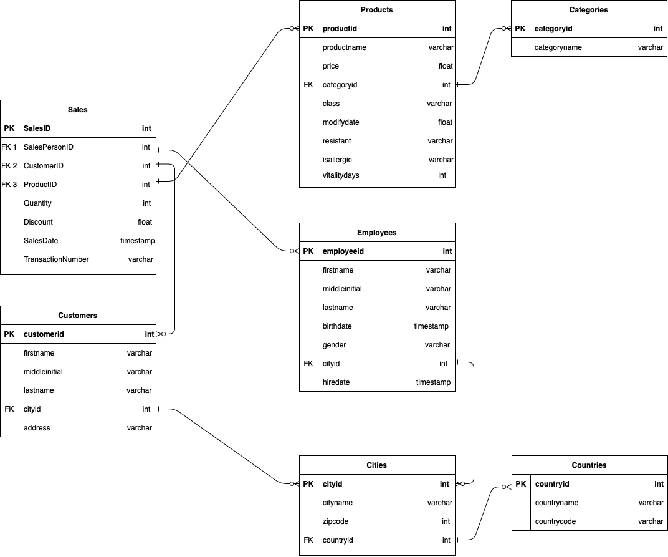
ERD RevoGrocers Dataset

Slide 5
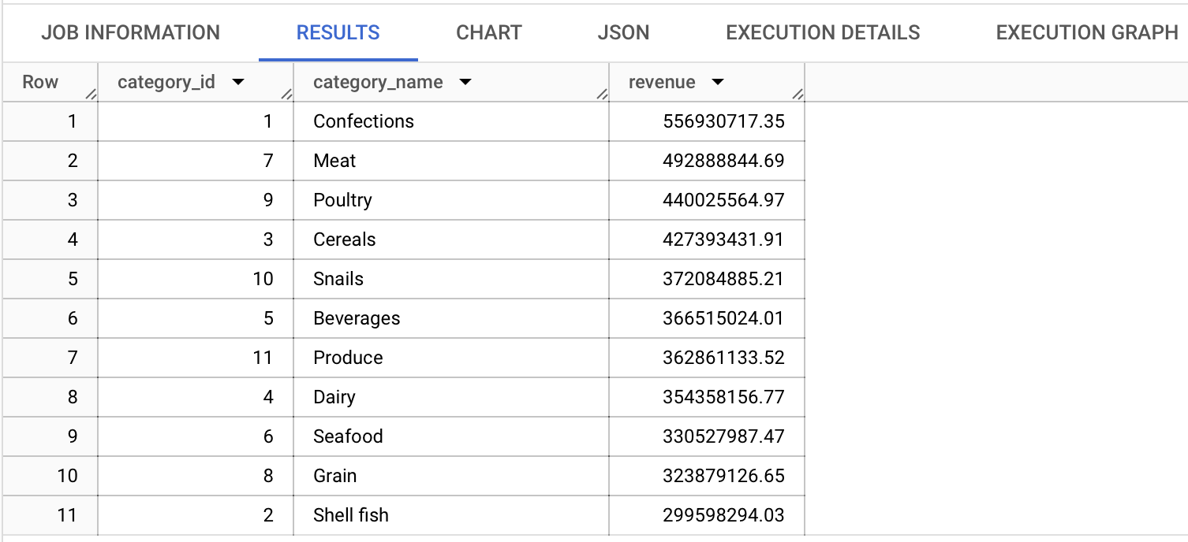

Top Revenue-Generating Product Categories
Which Product Category Drive the Most Revenue?
SQL Query
Query Output
Hypothesis
Alpha
Statistical Test
Kriteria Keputusan
Kesimpulan
Insight bisnis
-- Identify the product category that generates the highest revenue.
SELECT
categories.categoryid AS category_id
,categories.categoryname AS category_name
,ROUND(SUM(sales.Quantity * (1-sales.Discount) * products.price),2) AS revenue
FROM `fsda-sql-01.grocery_dataset.sales` AS sales
INNER JOIN `fsda-sql-01.grocery_dataset.products` AS products
ON sales.ProductID = products.productid
INNER JOIN `fsda-sql-01.grocery_dataset.categories`AS categories
ON products.categoryid = categories.categoryid
GROUP BY 1,2
ORDER BY 3 DESC;
We combined three tables—sales, products, and categories—using the INNER JOIN function to merge the category list with the products sold. This allows us to calculate revenue by using the SUM function as an aggregate function. Additionally, we apply the ROUND function to enhance the accuracy and readability of the results.
Insight
Top: Confections (556,93 Mio)
Lowest: Shell Fish ( 299,59 Mio)
Confections leading in revenue suggests strong customer demand for this category.
To leverage sales growth, we can expand Confections with more product variety or targeted promotions and boost Shell Fish sales with pricing strategies or marketing campaigns.

Slide 6
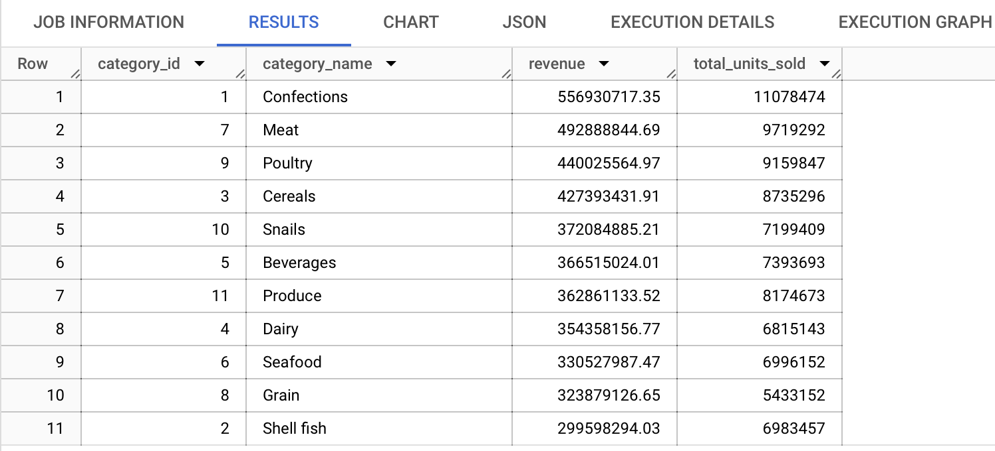
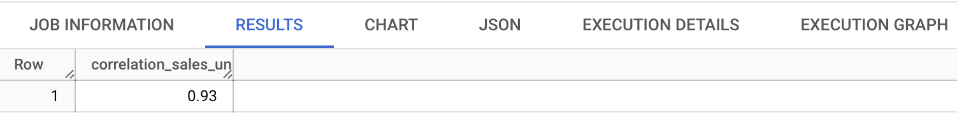
Correlation Between Revenue vs Total Units Sold
The correlation between revenue and total units sold per each product category
SQL Query
Query Output
-- Assess the correlation between revenue and total units sold for each product category.
WITH categories_sales AS(
SELECT
categories.categoryid AS category_id
,categories.categoryname AS category_name
,ROUND(SUM(sales.Quantity * (1-sales.Discount) * products.price),2) AS revenue
,SUM(sales.Quantity) AS total_units_sold
FROM `fsda-sql-01.grocery_dataset.sales` AS sales
INNER JOIN `fsda-sql-01.grocery_dataset.products` AS products
ON sales.ProductID = products.productid
INNER JOIN `fsda-sql-01.grocery_dataset.categories`AS categories
ON products.categoryid = categories.categoryid
GROUP BY 1,2
ORDER BY 3 DESC, 4 DESC
)
SELECT
ROUND(CORR (revenue,total_units_sold ),2) AS correlation_sales_units_sold
FROM categories_sales;
Hypothesis
Alpha
Statistical Test
Kriteria Keputusan
Kesimpulan
Insight bisnis
We used a Common Table Expression (CTE) to temporarily combine data from three tables—sales, products, and categories—using the INNER JOIN function. This allowed us to link product categories with the products sold and calculate revenue and total units sold using the SUM function as an aggregate.
Next, using the results from the CTE table (categories_sales), we analyzed the relationship between revenue and total units sold by applying the CORR function to measure their correlation.
Insight
If we analyze the data trend, it indicates a positive correlation between total units sold and revenue. Confections generates the highest revenue ($556.9M) and also records the highest total units sold (11.08M).
Meat and Poultry exhibit a similar pattern, where a higher number of units sold corresponds to higher revenue.
When assessing the correlation between revenue and total units sold for each product category using statistical analysis, we find that the correlation coefficient is 0.93, signifying a very strong positive correlation. This suggests that as revenue increases, the total units sold also rises, and vice versa.

Slide 7
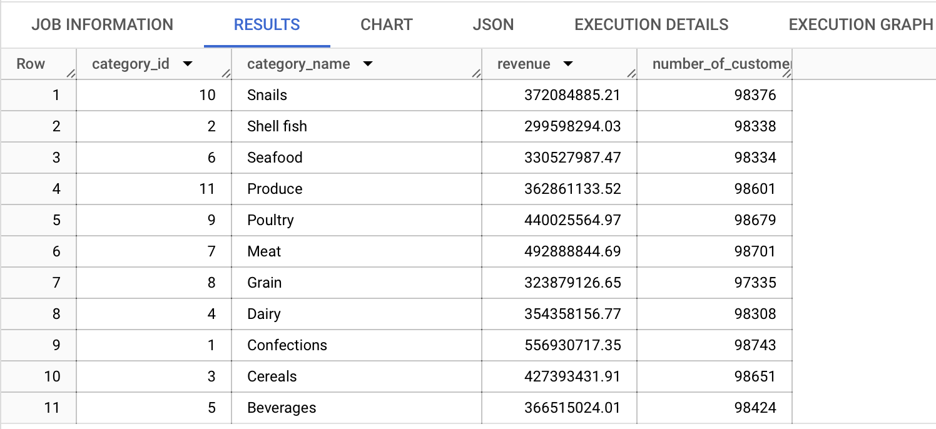
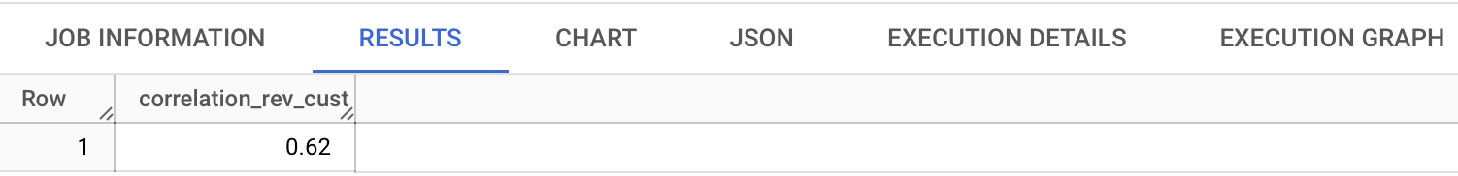
Correlation Between Revenue vs Number of Unique Customer
The correlation between revenue and number of unique customers for each product category
SQL Query
Query Output
-- Find the correlation between revenue and the number of unique customers for each product category.
WITH categories_sales_2 AS(
SELECT
categories.categoryid AS category_id
,categories.categoryname AS category_name
,ROUND(SUM(sales.Quantity * (1-sales.Discount) * products.price),2) AS revenue
,COUNT(DISTINCT sales.CustomerID) AS number_of_customer
FROM `fsda-sql-01.grocery_dataset.sales` AS sales
INNER JOIN `fsda-sql-01.grocery_dataset.products` AS products
ON sales.ProductID = products.productid
INNER JOIN `fsda-sql-01.grocery_dataset.categories`AS categories
ON products.categoryid = categories.categoryid
GROUP BY 1,2
ORDER BY 2 DESC, 1 DESC
)
SELECT
ROUND(CORR(revenue, number_of_customer),2) AS correlation_rev_cust
FROM categories_sales_2;
Hypothesis
Alpha
Statistical Test
Kriteria Keputusan
Kesimpulan
Insight bisnis
We used a Common Table Expression (CTE) to temporarily combine data from three tables—sales, products, and categories—using the INNER JOIN function. This allowed us to link product categories with the products sold and calculate revenue using the SUM and total unique customer using the COUNT DISTINCT function as an aggregate.
Next, using the results from the CTE table (categories_sales _2), we analyzed the relationship between revenue and total unique customer by applying the CORR function to measure their correlation.
Insight
If we analyze the data trend, it indicates a positive correlation between number of unique customer and revenue. Product categories with higher revenue also have a larger number of unique customers.
Confections, for example, has the highest revenue ($556.9M) and the highest number of customers (98,743).
Similarly, Meat and Poultry also show high revenue figures along with a large number of unique customers.
When assessing the correlation between revenue and number of unique customers for each product category using statistical analysis, we find that the correlation coefficient is 0.62, signifying a strong positive correlation. This suggests that as revenue increases, number of unique customers also increases, and vice versa.

Slide 8
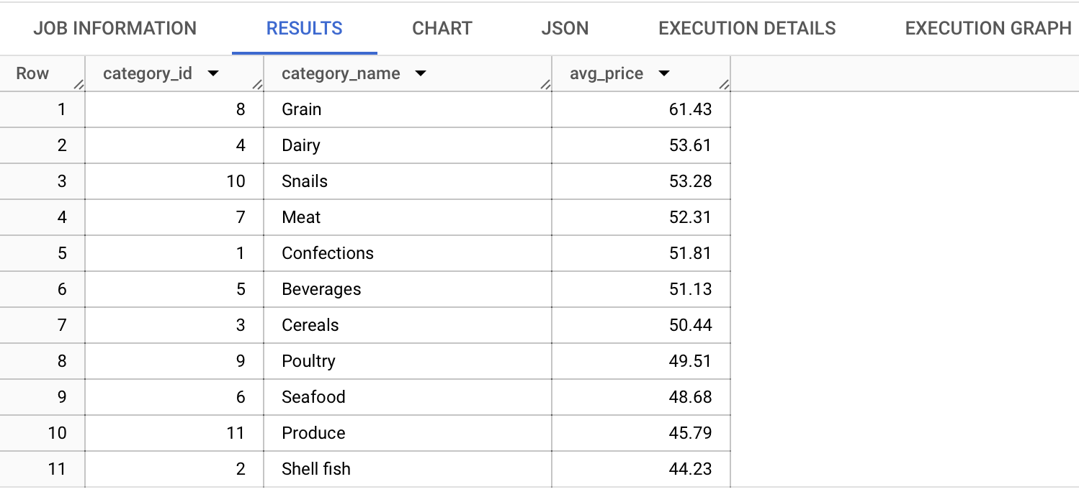
Average Price per Units for Each Product Category
the average price per unit for each product category
SQL Query
Query Output
--Calculate the average price per unit for each product category.
SELECT
categories.categoryid AS category_id
,categories.categoryname AS category_name
,ROUND(AVG(products.price),2) AS avg_price
FROM `fsda-sql-01.grocery_dataset.sales` AS sales
INNER JOIN `fsda-sql-01.grocery_dataset.products` AS products
ON sales.ProductID = products.productid
INNER JOIN `fsda-sql-01.grocery_dataset.categories`AS categories
ON products.categoryid = categories.categoryid
GROUP BY 1,2
ORDER BY 3 DESC;
Hypothesis
Alpha
Statistical Test
Kriteria Keputusan
Kesimpulan
Insight bisnis
We combined three tables—sales, products, and categories—using the INNER JOIN function to merge the category list with the products sold. This allows us to calculate avg_price by using the AVG function as an aggregate function. Additionally, we apply the ROUND function to enhance the accuracy and readability of the results.
Insight
Grain has the highest average price (61.43), but its revenue (323,87) ranks 10th out of 11 categories.This suggests that despite its high price per unit, its sales volume is low.
Dairy (53.61) and Snails (53.28) also have relatively high prices, but their revenue is lower than categories like Confections or Meat, indicating that higher prices may reduce customer demand.
Shell Fish has the lowest average price (44.23) and the lowest revenue (299,59), meaning that even with a lower price, its sales volume remains low.

Slide 9
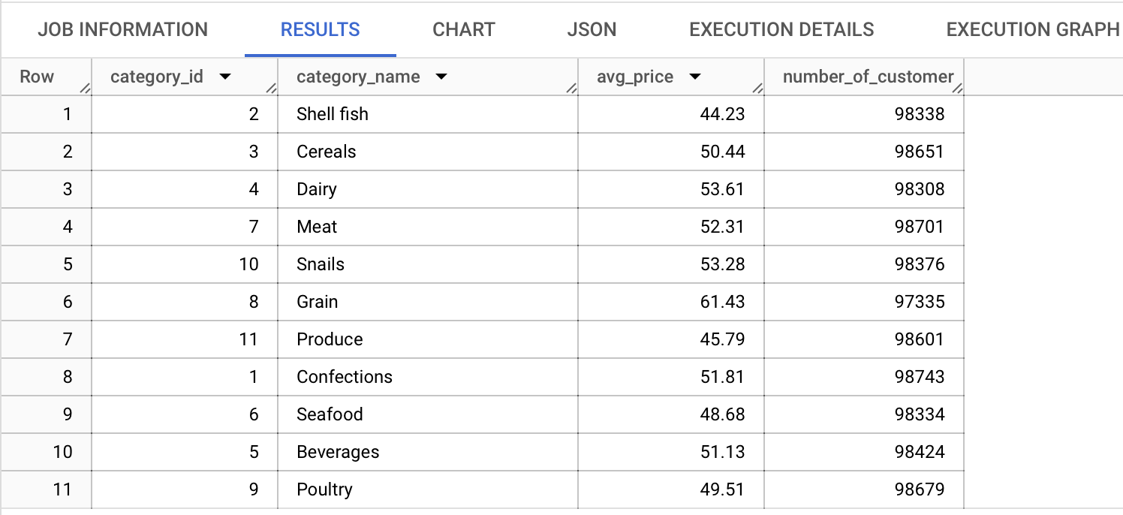
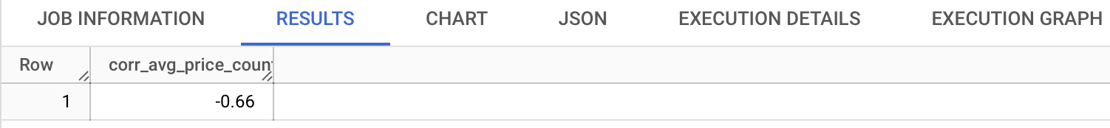
Correlation Between Avg. Price vs Number of Buyers
The correlation between the average price per unit and the number of buyers (unique customers) per category.
SQL Query
Query Output
-- Evaluate the correlation between the average price per unit and the number of buyers (unique customers) per category.
WITH avg_price_count_cust AS(
SELECT
categories.categoryid AS category_id
,categories.categoryname AS category_name
,AVG(products.price) AS avg_price
,COUNT(DISTINCT sales.CustomerID) AS number_of_customer
FROM `fsda-sql-01.grocery_dataset.sales` AS sales
INNER JOIN `fsda-sql-01.grocery_dataset.products` AS products
ON sales.ProductID = products.productid
INNER JOIN `fsda-sql-01.grocery_dataset.categories`AS categories
ON products.categoryid = categories.categoryid
GROUP BY 1,2
)
SELECT
ROUND(CORR(avg_price,number_of_customer),2) AS corr_avg_price_count_cust
FROM avg_price_count_cust;
Hypothesis
Alpha
Statistical Test
Kriteria Keputusan
Kesimpulan
Insight bisnis
We used a Common Table Expression (CTE) to temporarily combine data from three tables—sales, products, and categories—using the INNER JOIN function. This allowed us to link product categories with the products sold and calculate avg_price using the AVG and total unique customer using the COUNT DISTINCT function as an aggregate.
Next, using the results from the CTE table (avg_price_count_cust), we analyzed the relationship between average price per unit and total number of buyer (unique customer) by applying the CORR function to measure their correlation.
Insight
The correlation between the avg. price per unit and the number of buyers per category is -0.66, indicating a strong negative correlation. This means that when the avg. price per unit increase, the number of buyers tend to decrease, and when the avg. price per unit decreases, the number of buyers tends to increase. This indicates that price sensitivity plays a significant role in customer purchasing decisions.
From previous insight, Grain has the highest average price per unit ($61.43) but ranks 10th in revenue, confirming that high prices may have deterred customers.
This aligns with the basic law of demand in economics, higher prices often lead to lower demand and vice versa.

Slide 10
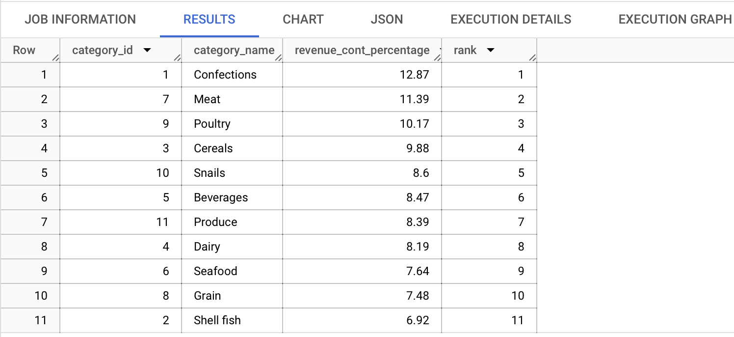
Top Contribute Product Categories
Which categories contribute the most to overall revenue (percentage-wise)?
SQL Query
Query Output
Hypothesis
Alpha
Statistical Test
Kriteria Keputusan
Kesimpulan
Insight bisnis
-- Which categories contribute the most to overall revenue (percentage-wise)?
WITH contribute_revenue AS(
SELECT
categories.categoryid AS category_id
,categories.categoryname AS category_name
,ROUND(100 * SUM(sales.Quantity * (1 - sales.Discount) * products.price)
/SUM(SUM(sales.Quantity * (1 - sales.Discount) * products.price))OVER(), 2) AS revenue_cont_percentage
FROM `fsda-sql-01.grocery_dataset.sales` AS sales
INNER JOIN `fsda-sql-01.grocery_dataset.products` AS products
ON sales.ProductID = products.productid
INNER JOIN `fsda-sql-01.grocery_dataset.categories`AS categories
ON products.categoryid = categories.categoryid
GROUP BY 1,2
)
SELECT
category_id
,category_name
,revenue_cont_percentage
,RANK () OVER (ORDER BY revenue_cont_percentage DESC) AS rank
FROM contribute_revenue
ORDER BY 4 ASC;
We used a Common Table Expression (CTE) to temporarily combine data from three tables—sales, products, and categories—using the INNER JOIN function. This allowed us to link product categories with the products sold and calculate the contribution percentage using the SUM function and arithmetic operations. The OVER function allowed us to divide the percentage by category, and to identify the top-contributing product categories, we used the RANK function.
Insight
Top: Confections (556,93 Mio) contributes 12.87% of total revenue.
Lowest: Shell Fish ( 299,59 Mio) contributes 6.92% of total revenue.
Confections leading in revenue suggests strong customer demand for this category.
To leverage sales growth, we can expand Confections with more product variety or targeted promotions and boost Shell Fish sales with pricing strategies or marketing campaigns.

Slide 11
Highest Repeat Purchase Rate (1/2)
Which product categories have the highest repeat purchase rate?
Hypothesis
Alpha
Statistical Test
Kriteria Keputusan
Kesimpulan
Insight bisnis
SQL Query
-- Which product categories have the highest repeat purchase rate?
-- count cust id who order > 1 / count unique cust id * 100 per category
WITH orders AS(
SELECT
products.categoryid AS category_id
,categories.categoryname AS category_name
,sales.CustomerID AS cust_id
FROM fsda-sql-01.grocery_dataset.sales AS sales
INNER JOIN fsda-sql-01.grocery_dataset.products AS products
ON sales.ProductID = products.productid
INNER JOIN fsda-sql-01.grocery_dataset.categories AS categories
ON products.categoryid = categories.categoryid
),
repeat_order AS (
SELECT
category_id
,category_name
,cust_id
,COUNT(cust_id) AS number_repeat_order
FROM orders
GROUP BY 1,2,3
HAVING COUNT(cust_id) > 1
),
repeat_customer AS (
SELECT
category_id
,category_name
,count (cust_id) AS number_repeat_customer
FROM repeat_order
GROUP BY 1,2
)
SELECT
orders.category_id
,orders.category_name
,repeat_customer.number_repeat_customer
,COUNT (DISTINCT orders.cust_id) AS total_unique_customer
,ROUND(100* repeat_customer.number_repeat_customer/COUNT (DISTINCT orders.cust_id),2) AS repeat_purchase_rate
FROM orders
INNER JOIN repeat_customer
ON orders.category_id = repeat_customer.category_id
GROUP BY 1,2,3
ORDER BY 5 DESC;
We used a Common Table Expression (CTE) to temporarily combine data from three tables—sales, products, and categories—using the INNER JOIN function. This allowed us to link product categories with the products sold and calculate the repeat purchase rate using the COUNT function, the COUNT DISTINCT function to find unique IDs, and arithmetic operations. To identify repeat customers—those who have made more than one purchase—we used the HAVING clause to filter out customers <=1.

Slide 12
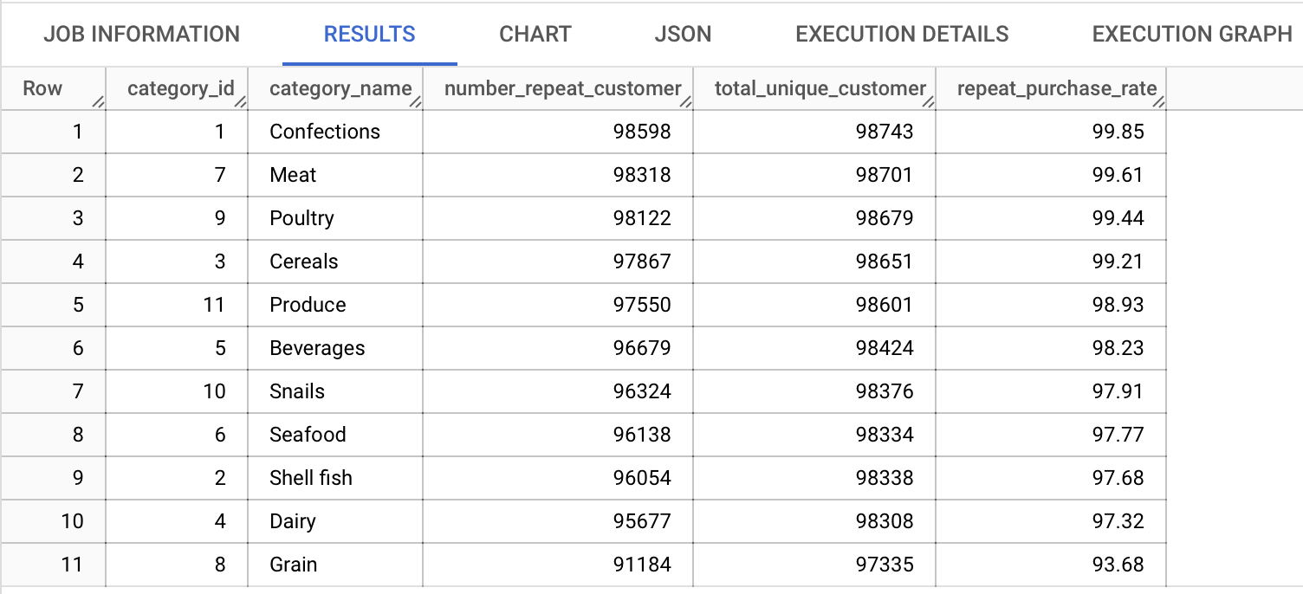
Highest Repeat Purchase Rate (2/2)
Which product categories have the highest repeat purchase rate?
Query Output
Hypothesis
Alpha
Statistical Test
Kriteria Keputusan
Kesimpulan
Insight bisnis
Insight
The Confections category has the highest repeat purchase rate at 99.85%, followed closely by Meat (99.61%) and Poultry (99.44%).
Confections has the highest number of customers (98,598), with a number repeat customer is 98,743, meaning nearly all customers who purchase from this category return for more.
Grain (93.68%) has the lowest repeat purchase rate among all categories, indicating that customers are less likely to repurchase products from this category because from the previous insight, Grain has the highest average price per unit ($61.43) but ranks 10th in revenue, confirming that high prices may have deterred customers.
Most food categories have a repeat purchase rate above 97%, indicating strong customer loyalty.
To further enhance retention, businesses can introduce loyalty programs, personalized recommendations, or special promotions for categories with slightly lower repeat purchase rates.

Slide 13
Summary
The top three product categories with the highest purchase rates are Confections (99.85%), Meat (99.61%), and Poultry (99.44%). These categories generate the highest revenue, have a large number of repeat customers, and contribute significantly to overall sales. In terms of average price, Confections and Meat are priced at a moderate level, while Poultry is among the top three most affordable categories.
Categories with higher average prices (e.g., Grain, Dairy, and Snails) tend to have fewer unique buyers, which aligns with their lower revenue rankings. This suggests that these products may be perceived as too expensive, leading to lower demand.
Despite having the lowest average price, Shellfish still ranks last in revenue, indicating that even with affordability, demand remains weak. This could be due to low market interest, niche demand, or supply constraints.
The correlation findings:
Revenue & Total Units Sold → Very Strong Positive Correlation (0.93): Higher revenue is closely linked to higher total units sold.
Revenue & Unique Customers → Strong Positive Correlation (0.62): More revenue generally means more unique buyers.
Average Price & Number of Buyers → Strong Negative Correlation (-0.66): As prices increase, the number of buyers decreases, indicating strong price sensitivity.
These correlations suggest that sales volume and customer reach drive revenue, while higher prices limit buyer interest.

Slide 14
Insight & Recommendation
1
High Purchase Rates in Confections, Meat, and Poultry Drive Revenue
Launch targeted promotions (e.g., volume discounts, loyalty rewards) to maintain and grow customer retention in these categories.
High-priced categories (Grain, Dairy, Snails) have fewer buyers due to price sensitivity Test price reductions or introduce smaller, budget-friendly package sizes to increase accessibility and demand.
Shellfish has the lowest revenue despite its affordability, indicating low consumer interest Conduct market research to identify barriers (e.g., awareness, availability, perception) and reposition the product with better marketing strategies.
2
3

Slide 15

THANK YOU

